Slide 1

The Truth About Marijuana
(Cannabis/THC):
Facts for Teens
Notes:
The Facts about Marijuana: Information for Teens was created by the
Chippewa Valley Coalition for Youth and Families, a school-community coalition in
mid-Macomb County, Michigan. It provides research-based information from
national sources, including the Centers for Disease Control and Prevention (CDC) and others.
This lesson takes approximately 2 hours to present, with activities and discussion.
It was reviewed by Sara Orris, School Health Consultant at the Macomb Intermediate School District,
and found to be compatible with the Michigan Model for Health.
A Message to Teachers and Others Using The Facts About Marijuana: Information for Teens:
Many children and adolescents today have significant misperceptions about marijuana.
National drug survey data, Monitoring the Future 2023, shows progressive declines in the
perception of adolescents that marijuana use can be harmful.
The intention of this power point lesson, with video, is to provide accurate, research-based
information to educate youth about the real dangers of marijuana use, especially during adolescence.
This power point lesson is intended to be used as an instructional unit for students in high school health
or other classes and/or for educational presentations to youth groups in other settings,
e.g., churches, recreational centers, etc.
When some adolescents are provided with information about the dangers of marijuana use,
they may respond with adamant disbelief, given their lack of fact-based information
and the likelihood that some are marijuana users. In piloting this unit, we discovered that expressions
of disbelief can lead to stimulating and helpful discussions.
We have also found it constructive to take the following positions, in presenting this information:
I am not trying to convince you of anything. I am providing you with research-based information to consider.
You might do some research yourself to see what you discover, however, there is much misinformation
about marijuana on the internet. I can give you some reliable and research-based resources to review.
Be careful to separate opinion from research-based facts.
Information to assist in using The Facts about Marijuana: Information for Teens:
Many of the slides have accompanying information.
These include Teacher Notes that provide supplemental information for teachers.
Other slides may have Teacher Comments, statements found useful during the piloting of the curriculum
to enhance student learning. Some Teacher Comments are purposefully informal to be “student friendly”.
In addition, some slides provide suggested Group Activities to promote discussion.
Supplemental materials-Cannabis: The Facts You Need to Know, created by the National Institute on Drug Abuse-are available for this lesson:
1. https://nida.nih.gov/sites/default/files/NIDA_YR20_INS1_StudentMagazine.pdf
2. https://nida.nih.gov/research-topics/parents-educators/lesson-plans/cannabis-the-facts-you-need-to-know
This presentation was updated during August 2024.

Slide 2
What is Marijuana?
Also called cannabis, dabbing, shatter, sparking up, THC, weed, pot, 420
A mixture of the dried and shredded leaves, stems, seeds, and flowers of the cannabis plant
Has a chemical in it called delta-9-tetrahydrocannabinol (THC) - the main addictive ingredient
        Centers for Disease Control and Prevention
Notes:
A Reminder – some of the following slides have
TEACHER COMMENTS, statements that may be used in class to enhance the lesson, and/or
TEACHER NOTES, supplemental information for teachers
Teacher Notes:
What is marijuana?
Marijuana refers to the dried leaves, flowers, stems, and seeds from the Cannabis sativa or Cannabis indica plant.
The plant contains the mind-altering chemical THC and other similar compounds.
Extracts can also be made from the cannabis plant.
Marijuana is often vaped and sometimes mixed into foods, “edible marijuana”, or drinks.
https://www.cdc.gov/cannabis/about/index.html

Slide 3

Group Activity
Estimate the percentage of 10th graders in an anonymous national survey that reported never using marijuana.
Notes:
Group Activity (Preparing students for next slide):
Estimate the percentage of 10th graders in an anonymous national survey that reported never using marijuana.
Write the estimated percentages on the board.
(The next slide provides the answer.)
The survey is the Monitoring the Future Survey conducted by the University of Michigan each year.

Slide 4
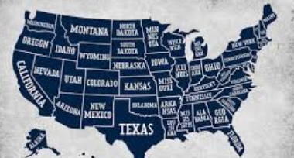
National Monitoring the Future Survey (2023)
Conducted by the University of Michigan
10th Graders
About 8 out of 10 had NEVER USED Marijuana
Notes:
Teacher Comments:
About 8 out of ten 10th grade students that took the survey said they HAD NEVER used marijuana.
How does this compare to your guess?
Many people your age overestimate the number of teens that use marijuana.
MOST TEENS DO NOT USE MARIJUANA.
The Monitoring the Future Survey is funded by the National Institute on Drug Abuse (NIDA),
part of the National Institutes of Health (NIH). The survey is conducted by the University of Michigan.
To view full survey data, visit https://www.drugabuse.gov/drug-topics/trends-statistics/monitoring-future

Slide 5
Why Do Some Teens Use Marijuana (Cannabis/THC)?
Pressure from friends
Boredom
Influence of media
Insecurity/To “fit in”
To rebel
To deal with uncomfortable feelings
Curiosity Misinformation (Believe it’s safe)
Partnership to End Addiction
Notes:
This slide contains animations.
Each mouse click will advance to the next item on the slide.
Group Activity: STOP THIS SLIDE AFTER THE QUESTION “Why Do Some Teens Use Marijuana?”.
Ask students the question more specifically, “Why do you think people your age try marijuana?”
Brainstorm and write their answers on the board.
Discuss some of their answers.
Resume showing the complete slide (STOP at “Believe it’s safe”) .
Note and discuss any reason why teens use marijuana that hasn’t been mentioned.
https://drugfree.org/article/why-teens-drink-and-experiment-with-drugs/ April 2024

Slide 6
Important lessons can be learned from the history of tobacco.
For a long time, people believed smoking cigarettes was safe.
Tobacco was even used as a medicine for different conditions.
Research began to link cancer to burned tobacco.
Tobacco companies tried to hide the dangers from the public.
Tobacco use caused millions of deaths before the public were made aware.
In 1998, the tobacco industry was fined $206 billion for the damage.
It took decades for the public to learn about the dangers of tobacco. How long will it take to understand the dangers of marijuana?
Scholastic Magazine
Notes:
Teacher Notes:
Read the slide and encourage discussion.

Slide 7
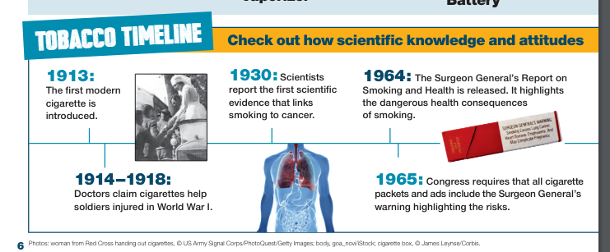
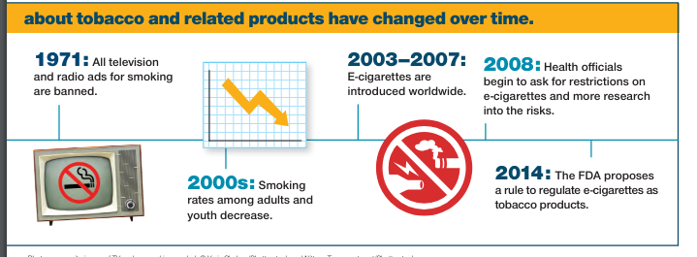
Timeline for Tobacco
Scholastic Magazine
Notes:
Teacher Comments:
Did you know that between 1914 – 1918 doctors mistakenly thought that tobacco could be used as medicine (see diagram)?
Did you know that from 1920 – 1950 many people smoked cigarettes and thought it was safe to do so?
People smoked openly in restaurants and public places. Most had ashtrays in their homes.
Movies, cartoons, advertisements often showed people smoking.
Group Activity:
Raise your hand if you believe that smoking tobacco cigarettes is dangerous. (Note that almost all or all hands are raised.)
What do you think happened to change people’s minds about smoking cigarettes between 1920 and today?
Allow class to brainstorm ideas – write them on the board if you choose.
Discuss the history of tobacco noting:
1920’s - Research started that showed the danger of smoking tobacco.
1930’s – First scientific link of smoking to cancer.
1957 - U.S. Surgeon General provides warning that smoking causing cancer.
1960’s – 1990’s - Warnings appear on packaging.
1971 – All television and radio ads for smoking are banned.
EMPHASIZE THAT IT HAS TAKEN ALMOST 100 YEARS TO CHANGE ATTITUDES
ABOUT THE DANGERS OF SMOKING TOBACCO, DESPITE CLEAR EVIDENCE THAT IT IS DANGEROUS.
MANY PEOPLE DISREGARD THE DANGERS OF USING MARIJUANA TODAY.
HOPEFULLY, IT WILL NOT TAKE 100 YEARS TO RECOGNIZE THE DANGERS OF MARIJUANA USE.
Diagram taken from Get Smart About Tobacco. Scholastic Magazine.

Slide 8

Marijuana (Cannabis/THC) is NOT Safe.
    Even though Michigan has legalized
    adult use of marijuana,
    research shows that…
    Marijuana is NOT a safe drug,
    especially for teens and young adults.
Centers for Disease Control and Prevention
Notes:
Teacher Comments:
In 2018, Michigan legalized the use of commercialized marijuana for individuals over the age of 21.
This does not mean that marijuana is a safe drug, especially for teens and young adults.
https://www.cdc.gov/cannabis/health-effects/brain-health.html

Slide 9
Marijuana (Cannabis/THC) is NOT Safe.
Not all plants are safe to smoke or eat. (Tobacco is a plant.)
Oleander, Holly, and Lily of the Valley are a few of the hundreds of plants that are poisonous.
Poison.org
    Heroin, cocaine, cyanide and strychnine are all harmful substances made from plants.
    Centers for Disease Control and Prevention
Notes:
This slide contains animations.
Each mouse click will advance to the next item on the slide.
Teacher Comments:
Some people might argue that marijuana is safe because it is a plant and is “natural”.
Consider that poison ivy is a plant that has negative effects just by touching it.
Some of you that have pets at home also know that there are dozens of house plants that can harm your pet – even kill it.
https://www.poison.org/articles/plant#poisonousplants
www.cdc.gov

Slide 10
Marijuana (Cannabis/THC) is NOT Safe.
The amount of THC, the addictive chemical in marijuana, has increased significantly over the years, making it a much stronger and more addictive drug today than it was in the past.
DANGER
New Scientist 2023
Notes:
Teacher Comments:
Delta-9-tetrahydrocannabinol (THC) is the main addictive ingredient in marijuana, responsible for many of its known effects.
Teacher Notes:
All forms of marijuana are mind-altering (psychoactive).
In other words, they change how the brain works. Marijuana contains more than 400 chemicals,
including THC (delta-9-tetrahydrocannabinol). Since THC is the main addictive chemical in marijuana,
the amount of THC in marijuana determines its strength or potency and therefore its effects.
The THC content of marijuana has been increasing since the 1980s.
New Scientist. Is cannabis today really much more potent than 50 years ago? 11 October 2023
https://www.newscientist.com/article/2396976-is-cannabis-today-really-much-more-potent-than-50-years-ago/#:~:text=The%20data%20shows%20a%20clear,has%20increased%20more%20than%20tenfold.

Slide 11
MARIJUANA (Cannabis/THC) HAS BECOME MUCH STRONGER
OVER THE YEARS
Cannabis Use Disorder (Addiction)
Anxiety, Depression, and Psychosis
School Failure and Dropout
Emergency Room Visits
Heart Attack and Stroke
Poison Control Calls
Centers for Disease Control and Prevention
DANGER
Notes:
This slide contains animations.
Each mouse click will advance to the next item on the slide.
Teacher Comments:
Addiction is a strong urge to keep taking a drug, even when it is causing harm
(problems in relationships, with academics, legal issues, emotional problems, etc.).
Further explanation of addiction is provided later in this power point.
Teacher Notes:
THC, the addictive element in marijuana, has increased significantly over time.
The data shows a clear trend: over the last 50 years, the average amount of tetrahydrocannabinol (THC)
in cannabis – the plant’s main psychoactive component – has increased more than tenfold.
New Scientist. Is cannabis today really much more potent than 50 years ago? 11 October 2023
https://www.newscientist.com/article/2396976-is-cannabis-today-really-much-more-potent-than-50-years-ago/#:~:text=The%20data%20shows%20a%20clear,has%20increased%20more%20than%20tenfold.

Slide 12

Marijuana (THC/Cannabis)
IS Addictive
Developing brains are vulnerable to addiction.
Teen brains are not fully developed.
About 1 in 6 teens who use marijuana become addicted.
The EARLIER marijuana use begins, the GREATER the risk of addiction.
SAMHSA
Notes:
This slide contains animations.
Each mouse click will advance to the next item on the slide.
Teacher Notes:
It is estimated that 10% (about 1 in 10) of those who use marijuana will become dependent on it.
The number goes up to about 1 in 6 in those who start using in their teens.
https://www.samhsa.gov/marijuana

Slide 13
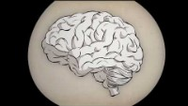
Video:
What is Addiction? (3:17 min)
Notes:
PLEASE NOTE THAT VIDEO MAY ONLY PLAY IN “SLIDE SHOW” MODE.
PLEASE ALLOW SEVERAL SECONDS FOR VIDEO TO LOAD.
Video Link: https://www.youtube.com/watch?v=MbOAKmzKmJo&t=1s

Slide 14
What are the effects of using Marijuana (Cannabis/THC)?
What Do You Think?
Notes:
Classroom Activity:
Ask the class “What are the effects of using marijuana?”
Write student answers on the board.
Proceed to show the next two slides.

Slide 15
What Can Happen When Someone
Uses Marijuana (THC/Cannabis)?
Potential Short-Term Problems
Marijuana use can interfere with:
Emotions (create anxiety, paranoia, panic)
Coordination
Memory
Thinking (create psychosis/distortion of reality)
Decision making
Concentration & Learning
Heart Rate
Scholastic, NIDA, NIH, Department of HHS
Notes:
Teacher Comments:
Every time a drug is used, including marijuana, there is a risk.
No one can control the effects marijuana will have on him/her.
Effects for the same person using marijuana may be different over time.
Some effects such as concentration/learning problems, and paranoia (unreasonable fear)/panic can last for days after marijuana is used.
Scholastic, NIDA, NIH, Department of HHS. Real News About Drugs and Your Body, 2023
https://nida.nih.gov/sites/default/files/NIDA_YR20_INS1_StudentMagazine.pdf

Slide 16
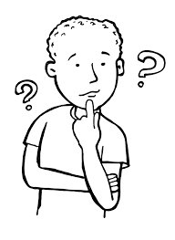
What Can Happen When Someone
Uses Marijuana (THC/Cannabis)?
Potential Long-Term Problems
Permanent brain changes
Cannabis Use Disorder (Addiction)
School failure and drop out
Depression, suicidal thoughts
Eating and sleeping problems
Breathing problems
Scholastic, NIDA, NIH, Department of HHS
CDC, UPI
Notes:
Teacher Comments:
There can be many negative long-term problems when someone uses marijuana.
Scholastic, NIDA, NIH, Department of HHS. Real News About Drugs and Your Body, 2023
https://nida.nih.gov/sites/default/files/NIDA_YR20_INS1_StudentMagazine.pdf
Centers for Disease Control and Prevention
https://www.cdc.gov/cannabis/health-effects/brain-health.html
Marijuana use in teenage years may hinder brain development, study finds - UPI.com

Slide 17
There is NO safe way to use marijuana.
Is Vaping Marijuana (Cannabis/THC)
Safer Than Smoking It?
Vaping high potency THC oils and concentrates increases the potential for addiction.
Devices used to vape THC can contain dangerous chemicals and metal particles from the device itself.
Pediatric Child Health Journal 2020
Notes:
This slide contains animations.
Each mouse click will advance to the next item on the slide.
Teacher Notes:
Though cannabis vaping is thought to generate fewer toxic emissions than cannabis smoking, it has been associated with several cases of acute lung injury and often involves high-potency forms of cannabis, exposing youth to several acute and long-term health risks.
Chadi N, Minato C, Stanwick R. Cannabis vaping: Understanding the health risks of a rapidly emerging trend. Paediatr Child Health. 2020;25(Suppl 1):S16-S20. doi:10.1093/pch/pxaa016

Slide 18
The Dangers of Marijuana (Cannabis/THC) Edibles/ Drinks
Marijuana edibles (e.g., cookies, candy bars, brownies) and drinks can have high and unpredictable levels of THC.
When marijuana edibles/drinks are used, the effects are often delayed.
The strongest effects of edibles may not be felt for several hours after the edible is eaten. When using THC drinks, the effects may not be felt for up to 45 minutes.
Given delayed effects, someone may eat or drink more to “get high”, leading to dangerous overdosing.
    Healthychildren.org
Notes:
This slide contains animations.
Each mouse click will advance to the next item on the slide.
https://www.healthychildren.org/English/ages-stages/teen/substance-abuse/Pages/Edible-Marijuana-Dangers.aspx

Slide 19
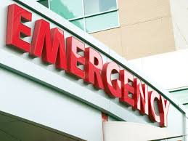
The
Dangers of Marijuana (Cannabis/THC) Edibles/ Drinks
Consuming edibles/drinks can result in overdose effects that include:
  Intoxication/altered perception
  Anxiety/panic/paranoia
  Dizziness
  Weakness
  Slurred speech
  Poor coordination
  Increased heart rate/breathing problems
  Uncontrolled vomiting
Healthychildren.org
Notes:
This slide contains animations.
Each mouse click will advance to the next item on the slide.
https://www.healthychildren.org/English/ages-stages/teen/substance-abuse/Pages/Edible-Marijuana-Dangers.aspx

Slide 20

Marijuana (Cannabis/THC)
Affects Each Person Differently
Effects vary based on:
Biology (e.g., gender, weight, family history of addiction)
Strength of the marijuana (amount of THC)
Whether alcohol or other drugs are also used
Amount used and how it is used (smoked/vaped/eaten/drank)
Centers for Disease Control and Prevention
Notes:
Teacher Comments:
Some people feel nothing at all when they use marijuana.
Others may feel relaxed or "high.“
Some experience sudden feelings of anxiety and paranoid thoughts.
The effects can be unpredictable, especially when other drugs are mixed with it.
https://www.cdc.gov/cannabis/about/index.html

Slide 21
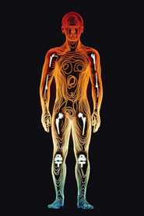
Marijuana (Cannabis/THC) &
Your Body
THC (Delta-9 tetrahydrocannabinol) rapidly passes from the lungs into the bloodstream, which carries the chemical to organs throughout the body, including the brain.
THC is quickly absorbed by various organs in the body, including the brain.
THC stays in the body for a long period of time.
Centers for Disease Control and Prevention
Notes:
This slide contains animations.
Each mouse click will advance to the next item on the slide.
https://www.cdc.gov/cannabis/about/index.html

Slide 22

How long do you think
THC stays in the body?
Notes:
Group Activity:
Have students answer the question, “How long does the THC in marijuana stay in your system?”
Write their answers on the board.
Comment on longest time and shortest time suggested by the class.
(The next slide provides the answer.)

Slide 23
The THC in marijuana can stay in the body for a long time.
THC can be detected in the body for up to
3 months.
The length of time THC remains in the body depends on how often it is used and the strength of the THC.
Notes:
Teacher Notes:
Detection of THC in urine samples is not exact science.
The number of days THC can be detected varies,
based on THC content and the metabolism of person being tested.
Web MD
https://www.webmd.com/mental-health/addiction/what-to-know-about-how-long-marijuana-stays-in-your-system
Website: IPassedMyDrugTest.Com.
http://www.ipassedmydrugtest.com/drug_test_faq.asp#detect_time

Slide 24


Stopping Marijuana (THC/Cannabis) Use Can Be Very Difficult.
When people try to stop using marijuana they often:
Are irritable & angry
Are stressed & nervous
Have problems eating & sleeping
Have urges to keep using it
American Psychiatric Association
Notes:
American Psychiatric Association. (2022). Diagnostic and statistical manual of mental disorders (5th ed., text rev.).
https://doi.org/10.1176/appi.books.9780890425787

Slide 25

Marijuana (THC/Cannabis)
& the Brain
Your brain is not fully developed until you are about 25 years or older.
Marijuana use can damage the developing brain, seriously affecting the ability to think, learn, remember, pay attention, and make safe decisions.
Centers for Disease Control and Prevention
Notes:
https://www.cdc.gov/cannabis/health-effects/brain-health.html

Slide 26

Video: Guide to the Teen Brain
(3:09 min)
Notes:
Before showing the video provide these instructions.
This video will inform us about the developing teen brain.
While we are watching, please write down one or two ideas that you think are important.
After seeing the video, I will ask you to share some of your thoughts.
PLEASE NOTE THAT VIDEO MAY ONLY PLAY IN “SLIDE SHOW” MODE.
PLEASE ALLOW SEVERAL SECONDS FOR VIDEO TO LOAD.
National Institute on Drug Abuse
Video Link: https://www.youtube.com/watch?v=EpfnDijz2d8&t=1s

Slide 27
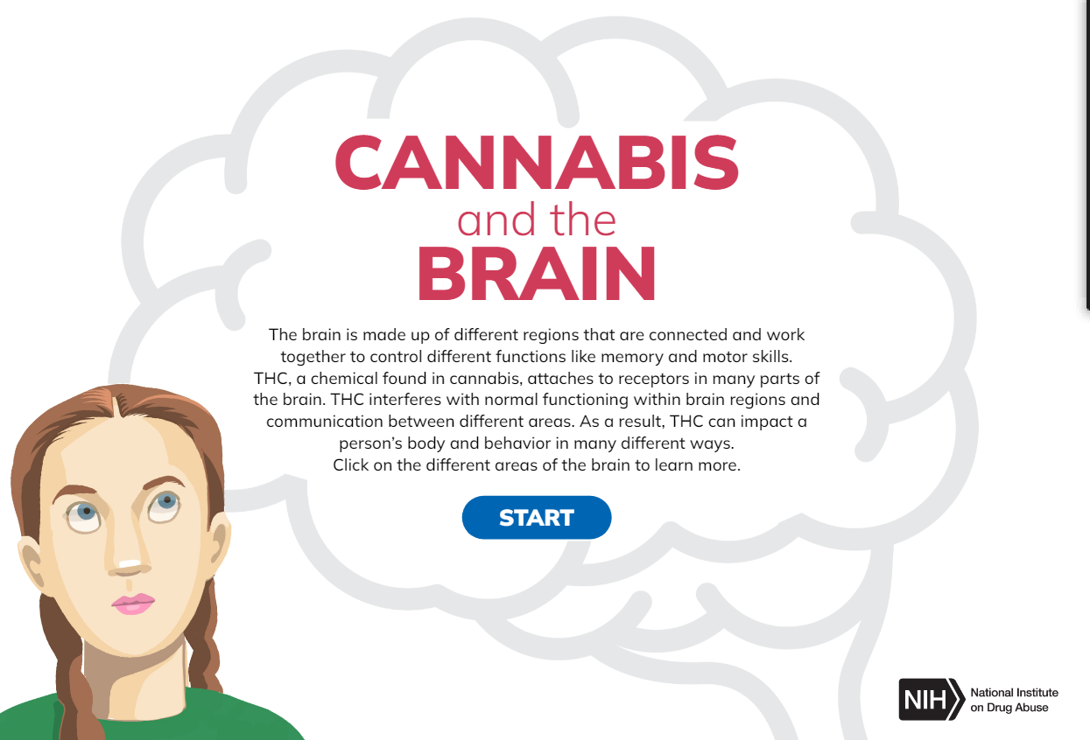
Activity: CANNABIS
(Marijuana/THC) and the BRAIN
https://nida.nih.gov/themes/custom/solstice/interactive/cannabis/
Notes:
Classroom Activity:
Click on the photo in the slide to access the activity about the effects of marijuana on the brain.
When each of the red dots turn blue, you know you have completed each section of the brain.
For easy reference, the parts of the brain are summarized below.
Cerebrum - area that controls the ability to think, plan, solve problems, and make decisions
Basal Ganglia – area involved in movement, thinking, and emotion.
Limbic System - area involved in memory and emotion processing.
Brain Stem – area involved in vital life functions.
Cerebellum – area involved in motor skills, such as balance and coordination, and plays an important role in the perception of time.
When the screen says GREAT JOB, return to this power point.
This link can also be used to get to this activity.
https://nida.nih.gov/themes/custom/solstice/interactive/cannabis/

Slide 28
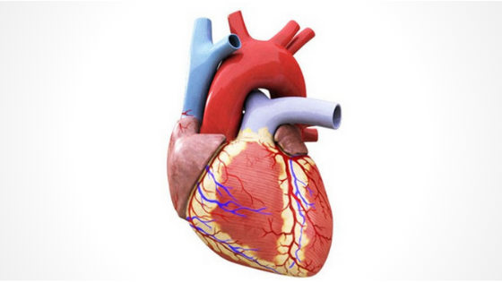
Marijuana (Cannabis/THC)
& the Heart
Marijuana can make the heart beat faster and raise blood pressure immediately after use.​
​
Marijuana use can lead to increased risk of stroke and heart disease.
Centers for Disease Control and Prevention​
Notes:
Teacher Notes:​​
Heart attack risk may be related to increased heart rate, as well as the effects of marijuana on heart rhythms, causing quick and irregular heart beats. ​
This can be a frightening experience for the person using marijuana.​
​
Centers for Disease Control and Prevention​
https://www.cdc.gov/cannabis/health-effects/heart-health.html

Slide 29
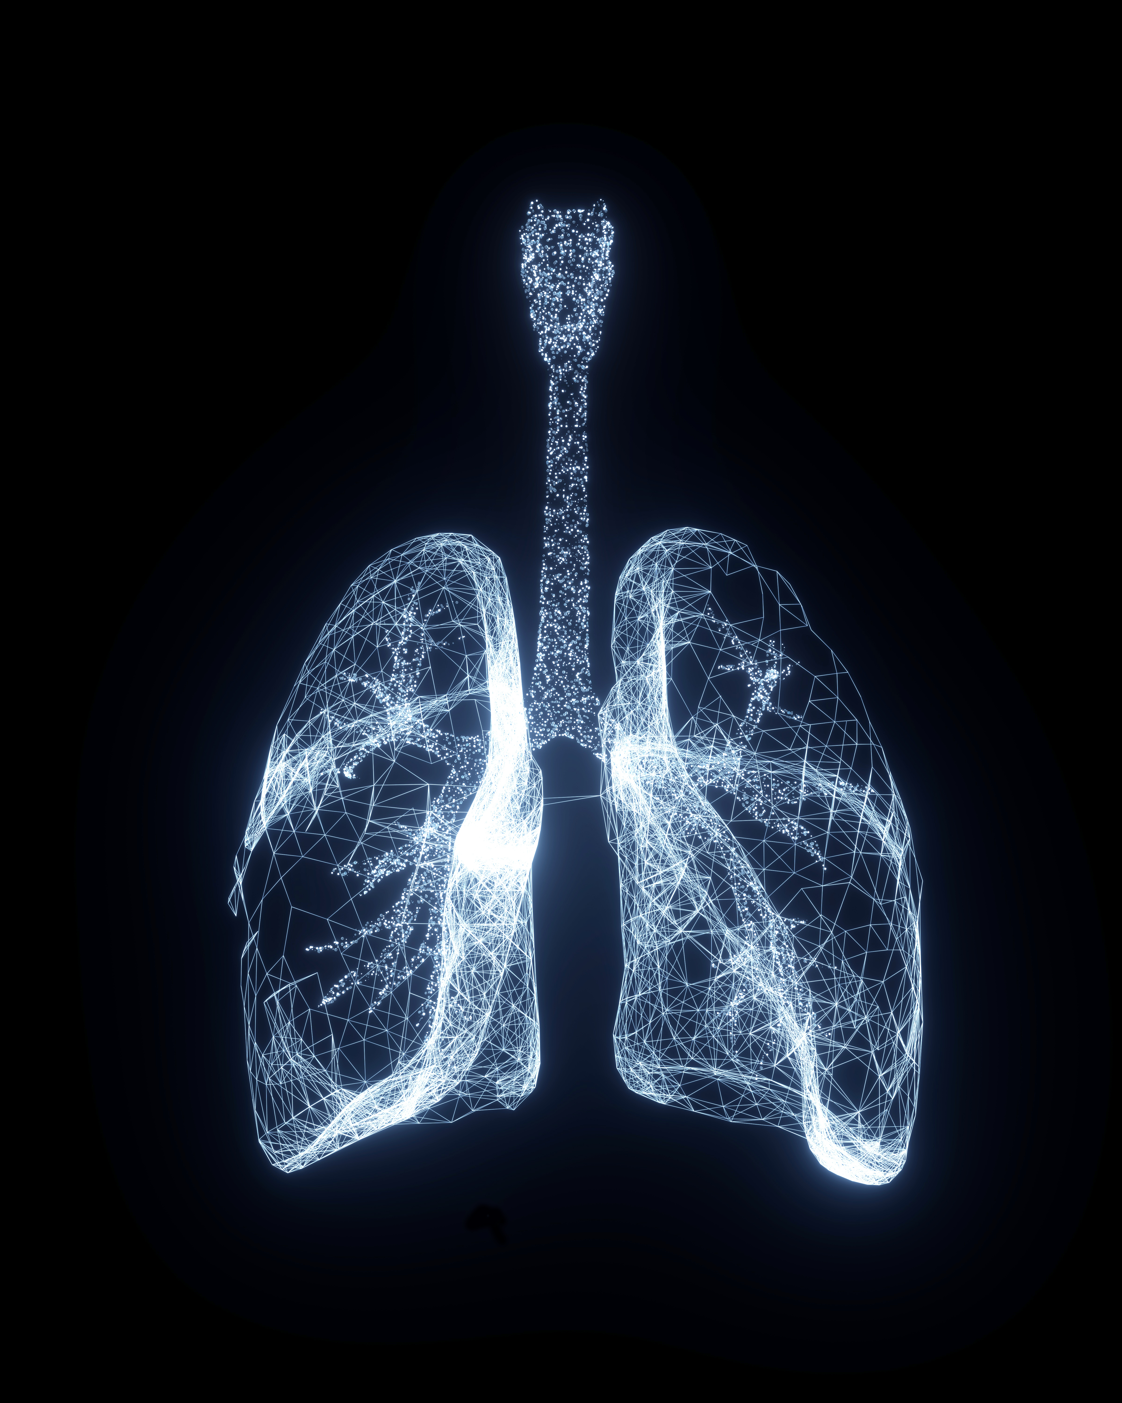
Marijuana (THC/Cannabis)
& the Lungs
Research has shown that vaping marijuana can cause lung damage.
Teens that vape marijuana are more likely to have breathing problems.
University of Michigan
Notes:
Vaping marijuana associated with more symptoms of lung damage than vaping or smoking nicotine
https://news.umich.edu/vaping-marijuana-associated-with-more-symptoms-of-lung-damage-than-vaping-or-smoking-nicotine/

Slide 30
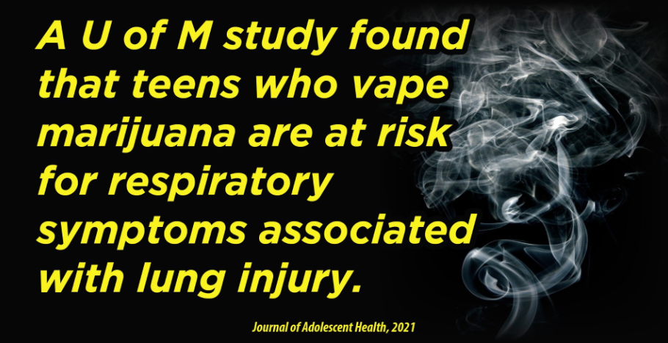
Marijuana (Cannabis/THC)
& the Lungs
Notes:
https://doi.org/10.1016/j.jadohealth.2021.01.019 2021 Society for Adolescent Health and Medicine.
https://www.jahonline.org/article/S1054-139X(21)00047-1/abstract

Slide 31

Can Marijuana (Cannabis/THC)
Use During Pregnancy
Harm the Developing Baby?
YES
Research shows that children of mothers who used marijuana during pregnancy are more likely to have trouble with problem-solving, memory, sleep, behavior, learning, and attention, which can be
life-long.
JAMA
Notes:
Teacher Comment:
Even low concentrations of THC used during pregnancy can have profound and long-lasting consequences for both the brain and behavior of a child.
Teacher Notes:
Research has shown that some babies born to women who used marijuana
during their pregnancies display altered responses to visual stimuli, tremors, and a high-pitched cry, which suggest problems with neurological development.
In school, marijuana-exposed children are more likely to show gaps in problem solving skills, memory, and the ability to remain attentive.
More research is needed, however, to determine the drug-specific factors from the environmental ones.
Paul SE, et al., Associations Between Prenatal Cannabis Exposure and Childhood Outcomes: Results From the ABCD Study.
JAMA Psychiatry. 2020 Sep 23:e202902. doi: 10.1001/jamapsychiatry.2020.2902.
https://pubmed.ncbi.nlm.nih.gov/32965490/

Slide 32

Marijuana (Cannabis/THC) use in pregnancy increases the risk of:
Early birth
Decreased birth weight (less than 5.5 pounds)
Smaller head size
Need for intensive care after birth
JAMA
Notes:
Paul SE, et al., Associations Between Prenatal Cannabis Exposure and Childhood Outcomes: Results From the ABCD Study.
JAMA Psychiatry. 2020 Sep 23:e202902. doi: 10.1001/jamapsychiatry.2020.2902.
https://pubmed.ncbi.nlm.nih.gov/32965490/

Slide 33
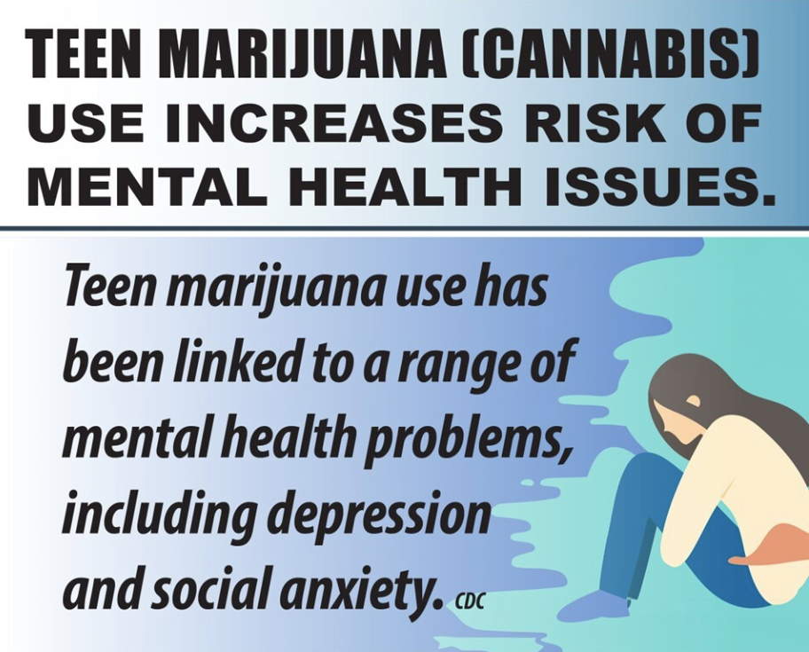
Marijuana (Cannabis/THC): & Mental Health
Centers for Disease Control and Prevention
Notes:
Teacher Comments:
Anxiety and depression are the most common disorders of childhood.
Regular use, particularly of high potency marijuana, has been linked to these and other mental health disorders.
Much more research needs to be done to discover the connection between marijuana and mental health.
https://www.cdc.gov/cannabis/health-effects/cannabis-and-teens.html

Slide 34
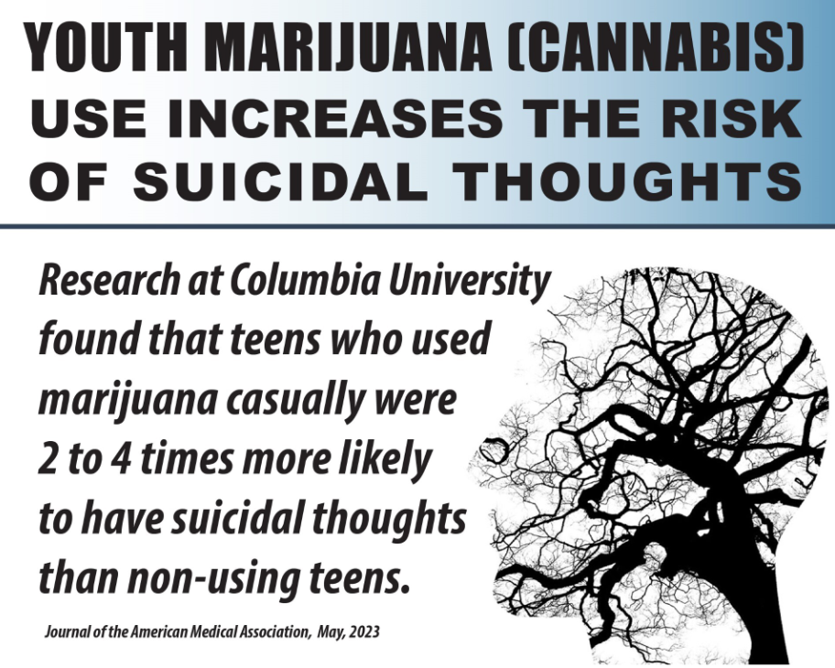
Marijuana (Cannabis/THC): & Mental Health
Notes:
Teacher Comments:
A reminder about suicidal thoughts –
if you or anyone you know is experiencing suicidal thoughts it is very important to talk with an adult you trust.
https://www.columbiapsychiatry.org/news/recreational-cannabis-use-among-u-s-adolescents-poses-risk-adverse-mental-health-and-life-outcomes

Slide 35
Marijuana (Cannabis/THC) & Acute Panic (Anxiety)
Some users of high potency marijuana experience acute panic. National Institutes of Health
Since it was legalized in Michigan for adult use, there has been an increase in visits to emergency rooms because of anxiety/panic reactions.
Keung et al, Cureus, 2023
Notes:
Teacher Comments:
Acute episodes of panic involve extremely high levels of anxiety.
https://medlineplus.gov/ency/article/000952.htm (National Institutes of Health)
https://pubmed.ncbi.nlm.nih.gov/37252542/
Keung MY, Leach E, Kreuser K, et al. Cannabis-Induced Anxiety Disorder in the Emergency Department. Cureus. 2023;15(4):e38158.
Published 2023 Apr 26. doi:10.7759/cureus.38158

Slide 36
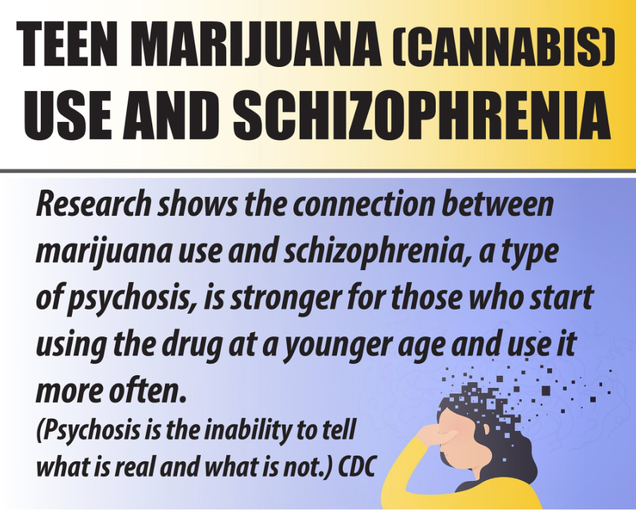
Marijuana (Cannabis/THC): & Mental Health
Centers for Disease Control and Prevention
Notes:
https://www.cdc.gov/cannabis/about/index.html

Slide 37

Marijuana (Cannabis/THC) use can close the door to your future!
Notes:
Teacher Comment:
The use of any drug, including marijuana has the potential of creating negative lifelong changes.

Slide 38

Marijuana (Cannabis/THC)
& School
The effects of marijuana use
on the developing brain can negatively
impact school performance.
Research shows that teens that use marijuana are more likely to drop out of high school.
SAMHSA
Notes:
https://www.getsmartaboutdrugs.gov/content/school-failure

Slide 39

Marijuana (Cannabis/THC)
& College Success
Students who use marijuana are MUCH LESS LIKELY to get a college degree.
Centers for Disease Control and Prevention
Research has shown the more frequently college students use marijuana, the lower their GPA tends to be, the more they report skipping class, and there is a greater likelihood of dropping out or taking longer to graduate.
Inside Higher Ed 2023
Notes:
https://www.cdc.gov/cannabis/health-effects/cannabis-and-teens.html​
​
https://www.insidehighered.com/news/2023/02/23/study-increased-marijuana-use-college-campuses#:~:text=Research%20has%20shown%20that%20the,it%20takes%20them%20to%20graduate.

Slide 40

Financial Aid & College Scholarships
Colleges have different requirements for scholarships.
Some colleges and universities may not allow a student to apply for or keep a scholarship if he/she has a conviction for a drug offense.
Don’t risk being unable to go to the school of your choice or losing your scholarship.
Just Think Twice, US Government
Notes:
Teacher Comments:
As part of the Free Application for Federal Student Aid (FAFSA) process, students convicted of a drug offense must complete an eligibility worksheet that will determine if they are eligible, partially eligible, or ineligible for student aid.
https://www.justthinktwice.gov/you-might-lose-your-student-loans-or-scholarship-drug-use

Slide 41
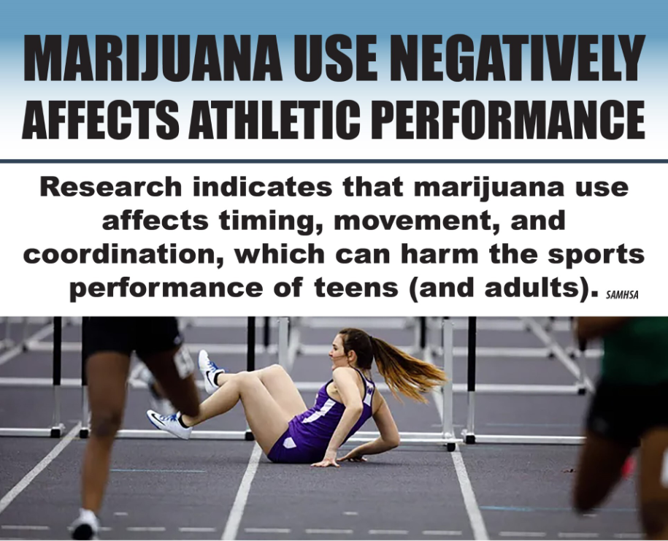
Marijuana (Cannabis/THC): & Sports
Notes:
Teacher Comments:
Marijuana can substantially decrease performance, given its proven negative effects on the mental and physical skills involved in playing a sport.
SAMHSA: Know the Risks of Marijuana 2024
https://www.samhsa.gov/marijuana

Slide 42
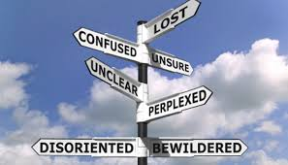
Marijuana (Cannabis/THC)
& Daily Life
Longtime Marijuana users report:
Less life satisfaction
Relationship problems
Reduced educational outcomes
Less career success
        SAMHSA
Notes:
This slide contains animations.
Each mouse click will advance to the next item on the slide.
https://www.samhsa.gov/marijuana

Slide 43
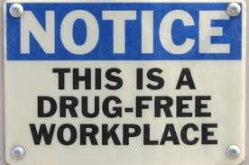
Marijuana (Cannabis/THC)
& Employment in Michigan
Even though marijuana use is legal for adults in Michigan, someone can be fired or not hired for a positive drug test if it violates the policy of the workplace.
MICHIGAN REGULATION AND TAXATION OF MARIHUANA ACT
Notes:
Teacher Note:
Michigan Marijuana Laws use an “h” instead of “j” to spell marijuana.
MICHIGAN REGULATION AND TAXATION OF MARIHUANA ACT
333.27954
Sec. 4. 3. This act does not require an employer to permit or accommodate conduct otherwise allowed by this act in any workplace or on the employer's property. This act does not prohibit an employer from disciplining an employee for violation of a workplace drug policy or for working while under the influence of marihuana. This act does not prevent an employer from refusing to hire, discharging, disciplining, or otherwise taking an adverse employment action against a person with respect to hire, tenure, terms, conditions, or privileges of employment because of that person's violation of a workplace drug policy or because that person was working while under the influence of marihuana.
Michigan Proposal 1, Marijuana Legalization Initiative (2018)
333.27954 Section 4 State of Michigan

Slide 44

What jobs could be negatively affected by Marijuana (Cannabis/THC) use?
Notes:
Class Activity:
Ask the class this question. What jobs could be negatively affected by Marijuana (Cannabis/THC) use?
Write the results of the brainstorm activity on the board.
Proceed to next slide.

Slide 45
MICHIGAN: People who work in these areas risk losing their state license if it is found that marijuana use negatively affects their job.
Acupuncture
Athletic Training
Audiology
Behavior Analysts
Chiropractic
Counseling
Dentistry
Marriage and Family Therapy
Massage Therapy
Medicine
Midwifery
Nursing
Nursing Home Administrator
Occupational Therapy
Optometry
Osteopathic Medicine and Surgery
Pharmacy
Physical Therapy
Physician’s Assistant
Podiatric Medicine and Surgery
Psychology
Respiratory Care
Sanitarian
Social Work
Speech-Language Pathology
Veterinary Medicine
Michigan License and Regulatory Affairs
Notes:
Class Activity:
Ask the class “Would you want someone under the influence of marijuana to be your Doctor? Dentist? Nurse? Pharmacist? Etc.
Why or why not?”
https://www.michigan.gov/lara/bureau-list/bpl

Slide 46
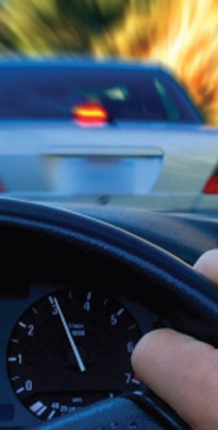
Marijuana (Cannabis/THC)
& Driving
Marijuana-involved fatal crashes have been increasing in Michigan.
People who drive under the influence of marijuana can experience dangerous effects, including:
Slower reaction time
Lane weaving
Decreased coordination
Difficulty reacting to signals and sounds on the road
HIDTA Michigan Report
SAMHSA
Notes:
This slide contains animations.
Each mouse click will advance to the next item on the slide.
University of Michigan Injury Prevention Center. Impact of Recreational Cannabis Legalization in Michigan:
A Baseline Report. University of Michigan. Ann Arbor, MI. May 2020.
https://injurycenter.umich.edu/wp-content/uploads/2022/01/2020_IPC_Cannabis_Report.pdf
https://www.samhsa.gov/marijuana

Slide 47

Marijuana (THC/Cannabis)
& Driving
Driving under the influence (DUI) laws do not just apply to alcohol. Driving under the influence of all other drugs, including marijuana, is dangerous and illegal.
Marijuana use before driving has resulted in serious auto crashes across Michigan.
Did you know?
It is also illegal
for marijuana
to be used
by passengers
in a car.
University of Michigan Injury Prevention Center, 2020
4200 Cannabis and Driving Brochure
Notes:
Teacher Comments:
After alcohol, marijuana is the substance most often associated with impaired driving.
Impact of Recreational Cannabis Legalization in Michigan: A Baseline Report. University of Michigan. Ann Arbor, MI. May 2020.
https://thenmi.org/reports/2020_IPC_Cannabis_Report_Michigan.pdf
4200-Cannabis-and-Driving-brochure.pdf (michigan.gov)

Slide 48
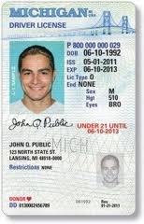
Even though commercial marijuana is legal for adults (21+) in Michigan, there are serious consequences for ANYONE that DRIVES UNDER THE INFLUENCE of Marijuana (Cannabis/THC).
The penalties are the same as those imposed for operating under the influence of alcohol. These penalties can include:
Up to 93 days in jail
Up to a $500 fine
License suspension
Six points on a person’s driving record
There are even greater penalties if a driver has minors in the vehicle.
4200 Cannabis and Driving Brochure
Notes:
This slide contains animations.
Each mouse click will advance to the next item on the slide.
If you are asked about points on a driver’s license you can explain as follows:
Each traffic violation or crime is worth a certain number of points, which is determined by the Michigan Vehicle Code.
Minor offenses are often two points, while serious crimes are up to six points.
Every point placed on your driver record stays there for two years from the date of your conviction.
If you plead guilty to a traffic violation, or you are found guilty by a court, then you will have driver’s license points assigned, and they will stay there the entire two years.
Accumulation of points can result in increased insurance cost, suspension of license and other consequences.
4200-Cannabis-and-Driving-brochure.pdf (michigan.gov)
http://www.mymichigandefenselawyer.com/michigan-criminal-laws/marijuana-possession/

Slide 49
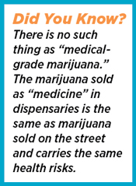
Marijuana (Cannabis/THC) is
NOT Medicine
The U.S. Food and Drug Administration (FDA) has approved some medications made from the cannabis plant, but those medications are only available through a doctor
and are not intended to
create a “high”.
FDA
Scholastic News
Notes:
This slide contains animations.
Each mouse click will advance to the next item on the slide.
Teacher Comment:
The U.S. Food and Drug Administration (FDA) has approved some medications made from the cannabis plant e.g., Marinol, Sativex, and Epidiolex, that contain chemicals from the plant, but are not intended to create a “high” for the user.
If a student mentions that a family member takes marijuana for a medical condition, you might state:
Yes, it is possible that some people use a form of marijuana they believe helps with a medical condition.
However, marijuana use has not been scientifically proven to be effective except for a few limited medical conditions.
Teacher Note:
It is known that unapproved cannabis and/or unapproved cannabis-derived products are being used to treat a number of medical conditions including, AIDS wasting, epilepsy, neuropathic pain, spasticity associated with multiple sclerosis, and cancer and chemotherapy-induced nausea. Caregivers and patients can be confident that FDA-approved drugs have been carefully evaluated for safety, efficacy, and quality, and are monitored by the FDA once they are on the market. However, the use of unapproved cannabis and cannabis-derived products can have unpredictable and unintended consequences, including serious safety risks. Also, there has been no FDA review of data from rigorous clinical trials to support that these unapproved products are safe and efficacious for the various therapeutic uses for which they are being used.
https://www.fda.gov/news-events/public-health-focus/fda-and-cannabis-research-and-drug-approval-process
http://www.scholastic.com/smp/pdfs/nida/NIDA10-INS3_Stu%20Mag.pdf

Slide 50
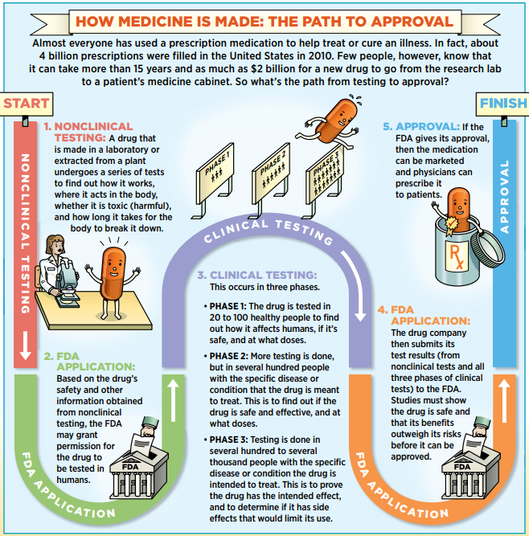
FDA: How Medicine is Approved
Scholastic News
Notes:
Teacher Comments:
This slide shows how complex the process is for any medication to be approved by the FDA for use by the public for a medical condition.
http://www.scholastic.com/smp/pdfs/nida/NIDA10-INS3_Stu%20Mag.pdf

Slide 51
Some Facts about Michigan’s
Medical Marihuana Act
  Medical Marijuana use is NOT allowed:
  While operating a car or any other motor vehicle, aircraft, or motorboat
  In a public place or on any form of public transportation, including a school bus
  In schools
  In a correctional facility
Michigan Medical Marihuana Act 2008
Notes:
Teacher Comments:
Sometimes people believe that there are no restrictions for “medical marijuana” use in the community.
This is not true.
Michigan Medical Marihuana Act 2008
http://www.legislature.mi.gov/(S(gpaghb2gfee2j0aattngi4eu))/
mileg.aspx?page=getobject&objectname=mcl-Initiated-Law-1-of-2008&query
=on&highlight=medical%20AND%20marihuana

Slide 52
What about CBD?
CBD products are widely marketed claiming many different uses.
CBD products found in stores are NOT approved by the U.S. Food and Drug Administration as treatment for any medical conditions.
Notes:
Teacher Note:
Is cannabidiol (CBD) medicine?
As of 2024, Scientists are still learning about how CBD affects the body.
The U.S. Food and Drug Administration (FDA) approved Epidiolex, a medicine that contains purified CBD from cannabis plants, to help treat seizure disorders.
The FDA has concluded that this drug is safe and effective for the intended use.
However, other marketed uses of CBD are not FDA approved.
There is ongoing research on the use of CBD-containing products for conditions such as epilepsy, PTSD, Tourette’s disorder, pain, and other diagnoses. For now (2024), the use of CBD is only FDA-approved in children for specific forms of epilepsy and in adults for chemotherapy induced nausea and vomiting. At this time, there is not enough evidence to recommend CBD for other uses, in children and adolescents including the treatment of autism and other developmental disorders. The approved CBD requires a prescription. Many stores sell CBD products. However, there are no safety and quality requirements for non-prescription CBD. They may have harmful additives or interfere with prescription medication.
https://www.aacap.org/AACAP/Families_and_Youth/Facts_for_Families/FFF-Guide/Marijuana-and-Teens-106.aspx
For more information visit SAMHSA: https://store.samhsa.gov/sites/default/files/pep22-06-04-003.pdf

Slide 53
Marijuana Matters: Let’s Sum It Up!
Any time you put drugs in your body, you risk serious and unpredictable physical and emotional damage.
Drug use, including use of marijuana, can have significant negative effects on your family relationships, mental health, friendships, school, athletic performance, and your future.
It’s important to find ways to manage feelings, deal with stress, and have fun without using drugs.
MOST TEENS DO NOT USE MARIJUANA, ALCOHOL, VAPE, OR USE OTHER DRUGS.
Notes:
This slide contains animations.
Each mouse click will advance to the next item on the slide.

Slide 54

Get The Facts…
For more research-based information:
www.cvcoalition.org
www.drugabuse.gov
www.teens.drugabuse.gov
www.cadca.org
www.nimh.nih.gov
www.niaaa.nih.gov
www.fda.gov
Notes:
Teacher Note:
Encourage students to go to one or more of these websites to check out the “cool” games, fact sheets, blogs, and interactive quizzes for teens.

Slide 55

Information Provided By:
www.cvcoalition.org
Notes:
The Chippewa Valley Coalition for Youth and Families is a school-community coalition in
mid-Macomb County, Michigan. We provide research-based prevention lessons on marijuana use for middle school students and vaping. These are also available free of charge on our website.

